Slide 1
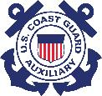
An Introduction to
Basic Boating Safety
Seminar
US Coast Guard Auxiliary
Notes:
Although this presentation was initially designed based on a request from the Ski boat industry and boat dealer partners for an entry level one to two hour seminar for a complete novice boater, it can be tailored to a more knowledgeable boater. Please be thoroughly familiar with all slides in this presentation and prepare any needed teaching aids, VSC material, and Recruiting material in advance. Preparation is the key to a successful presentation.
Ensure the accompanying resource document includes your up-to-date local and relevant resources. Print sufficient copies so everyone has a takeaway and can follow up on the resources you provide.
Like most of our seminars, this one is designed for local customization to fit your local needs. Feel free to change this presentation including slides and instructor notes to fit your local needs and to fit the time available for presentation. It is designed for one to two hours depending on number of teaching aids used and the amount of questions and answers received.
The more relevant to your audience, the better it will be received and the greater the chance for certificate course referrals as well as referrals for VSCs and potential members. This is your opportunity to “sell” what we have to offer in Recreational Boating Safety.

Slide 2
Purpose
This seminar course is designed to provide a boater with a brief overview of basic boating safety concepts
This seminar is NOT designed as a certificate course as its designed time for presentation and content does not meet the minimum standards for a certificate course recognized by NASBLA to meet state education requirements
This seminar is designed to expose the student to the concepts of boating safety that will be more fully developed in a certificate course and students should pursue additional education should they desire to complete a certificate course
Notes:
Tell them that this is only an introduction and their first step in learning to be a better and safer boater. More knowledge leads to better decisions which leads to less stress which leads to more fun. That’s what everyone who has a boat wants to do – have fun and do it safely!

Slide 3
Agenda
Orientation and introductions
What do you want to learn?
Who are we?
Introduction of critical knowledge for safe boating
Opportunity to learn more
Resources
Next steps
Notes:
Quickly tell them what you are going to tell them. Don’t spend much time here – you will go into more detail during the presentation for each point listed.

Slide 4
Orientation and Introductions
Introduce yourselves and your boat
Where do you primarily use your boat?
What do you want to learn from this seminar?
Notes:
Careful not to take too long on this task. Brevity is important and responses may reveal the need for a sidebar conference after the presentation.

Slide 5
Who Are We?
The Coast Guard Auxiliary is the volunteer civilian component of the US Coast Guard. Members can be trained and qualified to perform the same duties as the active duty with the exception of law enforcement activities. They also can serve as instructors for active duty members.
Members participate in programs that interest them and volunteer their time and talent to carry out those missions based on their available time to commit. All member training is free to our members.

Slide 6
Know Before You Go
Check the Weather
Develop and follow a checklist made specifically for your boat
File a Float Plan – Coast Guard App
Notes:
Download the Coast Guard app on your phone or tablet and pass it around to show the app’s capability.
Consider developing a checklist for demonstration purposes. Explain the idea of the checklist we use on operational facilities prior to every mission, but modified to fit their situation. Explain why everyone should customize their checklist for their particular boat.
Explain a float plan and it’s purpose. Explain how to cancel it after the boating day is over and everyone is safely at their destination.

Slide 7
Being Safe
Coast Guard Boating Safety Statistics show that operator inattention and failure to maintain a proper lookout are the top two contributing factors in boating accidents. Number three is operator inexperience.
Keep SITUATIONAL AWARENESS at all times and use your crew to help maintain it.
Have a designated Skipper capable of full operation of the boat if alcohol is part of your day on the water.
Notes:
Situational awareness is simply knowledge of what is happening in the environment around you. Boat drivers will have limited ability to see 360 degrees around them and may not be aware of threats developing. Use your crew to be extra eyes and ears to notify the boat driver of impending issues that could affect safety. Assign “sectors” for crew watch and change them out from time to time. Safety on the water is no accident and enlisting crew to help maintain an effective watch is critical for safe operation.

Slide 8
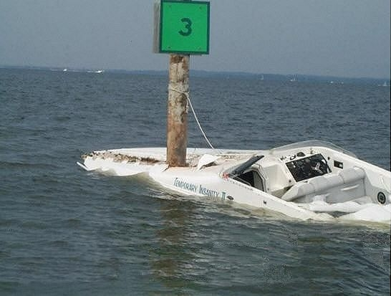

Situational Awareness?
Notes:
Note the name of the boat

Slide 9
Life Jackets
Coast Guard Boating Safety Statistics show that over 85% of accident victims who drowned were not wearing a life jacket and that accounted for 76% of all boating deaths in 2017
A Life Jacket not worn on your boat is like a seat belt in your car not fastened – it can’t help you if an accident occurs
Federal law requires those under age 13 to wear it. State laws may vary on age requirements so check locally
Notes:
If time permits, bring a variety of sizes of life jackets and ask participants to put them on while you run a stopwatch. The idea is to show them that it takes time to find them, size them properly, and actually put them on. Then remind them that this is on dry land with no emergency and how much that dynamic changes in the water when a real emergency occurs. This will be an eye opening experience for most participants.

Slide 10
Education
Notes:
This is why we do what we do. This slide was taken directly from the annual Coast Guard Boating Safety Report for 2017.
Note the difference in provider of instruction with USCGA, USPS, and Red Cross TOGETHER at 1.9% of deaths. This statistic speaks volumes about the quality of our instruction versus other providers. Main point is that over 80% had NO instruction.

Slide 11
Vessel Safety Check
We offer FREE Vessel Safety Checks to ensure your boat meets the MINIMUM legal standards required by law
We also discuss equipment not required by law, but a prudent mariner would have aboard and know how to use
Annual program and when you pass you display a decal
Not a get out of jail free decal, but it shows you met the requirements on the day of the examination
Notes:
Ideally, have a VSC qualified member talk about this slide. Pass out VSC Sheets to participants and show a current decal. Make sure they know how to contact us to schedule a VSC. Better yet, get contact information and schedule a VSC for the participant at this presentation.

Slide 12
Aids to Navigation
Aids to Navigation tell you where to go and where to avoid
They help identify your location on a chart
US Aids to Navigation System (IALA-B)
Introduce the Lateral System
Notes:
Utilize local chart or map for reference. Show ATONs on the chart or map.
You MUST have proper orientation and understand your current position and direction of travel before you begin your trip. It is critical to always maintain situational awareness of your position as it relates to the chart regardless of whether you utilize paper or electronic charts or better yet - both.
The Aids to Navigation system used on the majority of American waterways is referred to as the U.S. Aids to Navigation System or IALA-B. It’s major components are Buoys and Beacons. There are additional aids to navigation that will be introduced in later slides such as ICW markings and ATONS used in inland lakes.
Buoys are Aids that float on top of the water, but are moored to the bottom of the body of water. Some have a light affixed to the top; some do not. A buoy with a cylindrical shape and a conical top is referred to as a “nun.” A buoy with a cylindrical shape and a flat top is called a “can.”
Beacons are Aids that are permanently fixed, most commonly to the bottom of a body of water. A beacon that has a light attached is simply referred to as a “light”; a beacon without a light attached is called a “daybeacon.”
Both buoys and beacons can provide a variety of navigation information via shape, color, light, and/or audible signal.
Dayboards are informational signboards. The term topmark refers to a non-lighting element, such as a sphere, that may be affixed to the top of an Aid.
Lateral Aids to Navigation are generally used for well-defined channels to indicate the route to be followed. These Aids show the sides of a navigable channel, mark junctions and forks or splits in the channel, indicate the safe side to pass a hazard to navigation, and mark the safe centerline on wide bodies of water. They are used in conjunction with a conventional direction of buoyage (a local direction of buoyage when approaching a harbor, river estuary, or other waterway from seaward).

Slide 13


ATONs
Right side of channel returning from sea or traveling upstream
Red color, red light, even numbers, cone shaped NUN buoys
Left side of channel returning from sea or traveling upstream
Green color, green light, odd numbers, cylinder shape CAN buoys
Notes:
This slide begins the discussion of what is an ATON. Explain that you can see the shape before you see the color, and you can see the color before you see the number. This helps with longer range identification of ATONS. Same idea applies to daymarks.
Although a more advanced technique, explain that a daymark is positioned to be viewed directly when you are in the marked channel. Example – if an daymark is viewed ahead and as you pass it, the angle of the daymark on the other side of the pole shifts 45 degrees to the right, then the channel has made a 45 degree turn to the right and the next daymark should be seen in this direction. The direction of the boards point you in the direction of the channel. Slide 16 illustrates this point.

Slide 14
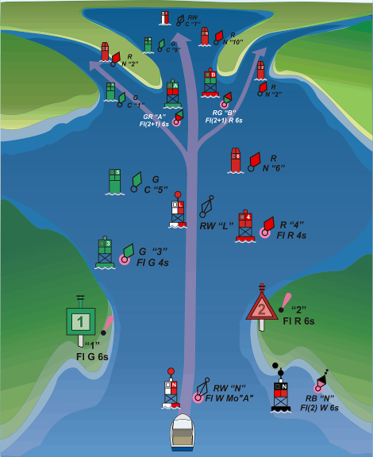
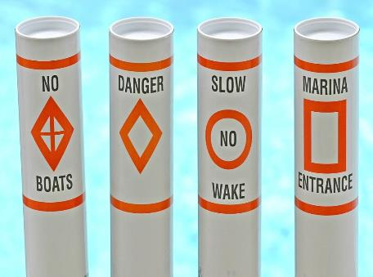
ATONs
Notes:
If no local chart is available, explain this generic slide of inlet markers
Point out red triangles mark right side returning from sea or upstream in a river and green squares mark left side
The right illustration are the markers commonly used on lakes and rivers. One additional marker not illustrated is a cylinder marked with vertical black or red stripes that mark the end of an obstruction. DO NOT PASS between this marker and the nearest shore. There are often Danger markers along the line of obstruction with the black or red strip marker indicating the end of the obstruction.

Slide 15
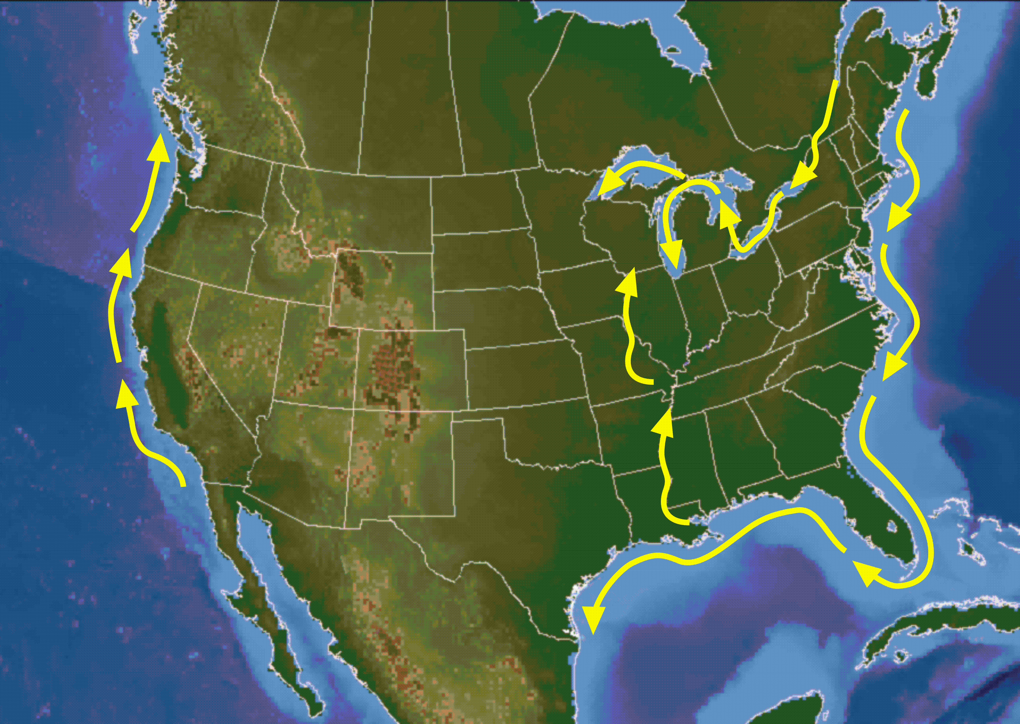

Red Right Returning
Notes:
You may have heard the phrase, “Red, Right, Returning.” This expression refers to the fact that when returning (entering a channel from the open sea or proceeding upstream), a boater must keep the red Aids on the right (starboard) side of the boat. These Aids have even numbers, and the numbers should increase as you proceed inland. For the ICW, it is clockwise around the US and east to west in the Great Lakes (upstream as the lakes flow through the St. Lawrence River to the ocean).
ICW marks are yellow triangles for the red side and yellow squares for the green side. This is true regardless of the color or shape of the ATON they are painted on. Use caution and verify the mark on any ATON near an inlet with the ocean as sometimes an ATON marking an inlet can also serve a dual purpose marking the ICW channel.
One such example is at the St. Augustine FL inlet where a yellow square marking the left side of the channel traveling southbound on the ICW is painted on a red floating nun buoy. In this example, if following the ICW you should keep the yellow square mark on your left as you intersect with the inlet channel. The red floating ATON is marking the inlet channel if returning from sea and you would keep the red on your right if you intend to follow the inlet channel. The fact that it also contains a yellow square is of no consequence to you unless you intend to turn at this marker and proceed northbound on the ICW. In this example, it marks the right limit of your travel for both the inlet and ICW and the appropriate location for your turn to the north. This particular inlet like many along the coast, is subject to constant changing positions of the channel due to storms.
The next slide shows an illustration of a yellow square on a green marker which is far more commonly encountered when transiting the ICW.

Slide 16
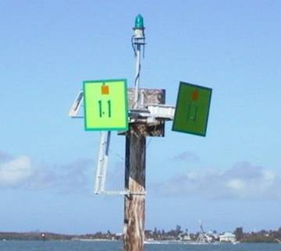
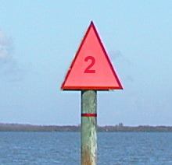
ATONs - Daymarks
Notes:
Note ICW symbol on left photo. A yellow square marks the left side of the channel if following the ICW in a clockwise direction. This means southbound on the east coast and westbound on the gulf cost after crossing the southern tip of Florida. Refer to the previous slide for an illustration of the ICW direction of lateral marks. Also notice the 90 degree turn of this channel.
Although the right illustration is a red marker, note is does not have a yellow triangle which means it is NOT marking the ICW. A Yellow triangle would be for the red side if following the ICW in the same direction in the example above.
Although a more advanced technique, explain that a daymark is positioned to be viewed directly when you are in the marked channel. Example – if an daymark is viewed ahead and as you pass it, the angle of the daymark on the other side of the pole shifts 90 degrees to the right, then the channel has made a 90 degree turn to the right and the next expected daymark ahead should be seen in this direction. The direction of the boards point you in the direction of the channel.
Note that daymarks are on poles driven into the ground and are by definition in shallow water so don’t go too close.

Slide 17
Navrules
Download from Coast Guard Navcenter Website www.navcen.uscg.gov/
If boat is over 40 feet long (12 meters), a copy is required to be carried onboard. Electronic copies permitted if it can be accessed in two minutes.
Notes:
Listed as a resource on the handout
Also part of the Coast Guard app
If circumstances permit, go to the website and show them where to find info desired

Slide 18
Navrules
Governs actions to be taken by Captains in meeting, crossing, and overtaking situations
Stand On vessel required to maintain course and speed
Give Way vessel required to alter speed and/or course to avoid the Stand On vessel
YOU are required to avoid a collision even if doing so breaks one of the rules.
Notes:
If teaching aids are available to demonstrate meeting, crossing, and overtaking situations students understanding will be enhanced by visualization. Some Instructors use toy boats as teaching aids.

Slide 19
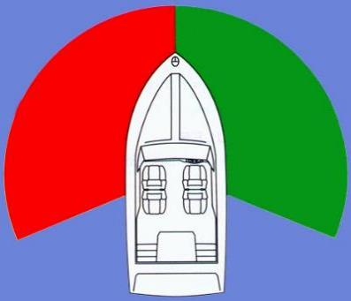
Navrules
Lights and light sectors / visibility
Notes:
Explain the 135 degree white sector with red and green sectors each at 112.5 degrees (225 degrees) making a total of 360 degrees.
If you have teaching aids (toy boats) move boats into position and explain how one boat would see a red light and then ask students what does red mean. Common response is to stop. Tell students this means if you would see the red sector, you must give way.
Move the toy boats into a position where they would see a green light and ask students what does green mean. Common response is to go. Tell students that if they see the green sector, they are the stand on vessel and they must continue with same course and speed so the other boat can maneuver or change speed to give way.
If they see white, they are overtaking a boat and must give way. The boat with the white light is the stand on vessel.
Also tell them that now they know more about the proper way to meet, cross, or overtake another vessel than most other boaters and to assume the other guy does not know what they know. Be prepared to break these rules to avoid a collision.

Slide 20
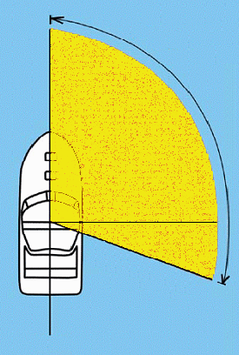
Navrules
Lights and light sectors / visibility
Dead ahead
DANGER ZONE 112.5 DEGREES
(FROM DEAD AHEAD TO
22.5 DEGREES ABAFT
THE STARBOARD
BEAM).
Starboard beam
22.5 DEGREES ABAFT
STARBOARD BEAM
Astern
Notes:
This slide demonstrates an easy way to determine who is give way vessel and who is stand on vessel. Keep it simple by saying any vessel appearing in the general direction of the yellow shaded area is the stand on vessel and YOU must stay out of their way. If it appears anywhere else, you become the stand on vessel and they must avoid you. Remind them again that most other boaters don’t know as much about this rule as they do and be prepared to take action to avoid a collision.

Slide 21
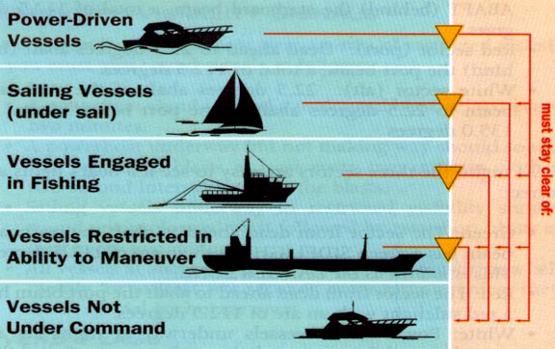

Hierarchy of Maneuverability
Notes:
Seaplane is a bonus answer for the highest in maneuverability. In the air, its an airplane. Once touched down on the water, it is a power boat.
Go down the list of what constitutes boats in each category. A sail boat under engine power is a power boat. A bass boat fishing is not categorized as a fishing boat – it is a power boat. Give examples in each category. Courtesy and discretion is paramount when around other boats. Understand that big vessels may not be able to see what is directly in front of them for hundreds of yards and they may not be able to stop or maneuver around you due to currents and channel width.

Slide 22
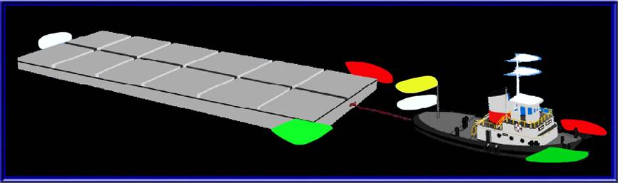
Lights on Tows
Notes:
If it has more lights than you – stay out of its way! Don’t get too deep in the weeds with explanation – keep it simple but make sure they understand that there is a big cable between the tow and the barge and they will have a very bad day if they try to pass there.

Slide 23
Fueling Safely
Close all doors and hatches BEFORE fueling and ask all passengers to disembark
Turn off everything electrical
Portable fuel tanks should always be removed from the boat and placed on the dock when filling
Keep the nozzle in constant contact with the fill pipe
Use an absorbent towel to catch any potential overflow and listen for the fuel filling. Stop before you get to the top
Notes:
Note that it is easy to spill fuel when filling portable tanks and any overflow will go to the bilge and create a fire and explosion hazard. Removal from the boat negates the opportunity for a fuel spill inside the hull.
Keeping the fuel nozzle in constant contact with the filler pipe connects the grounding of the boat with the grounding of the fuel system on the dock and eliminates the possibility of a static discharge and with a spark which could create a fire or explosion.
Fueling is one of the most dangerous operations on a boat, but doing it safely greatly reduces risk.

Slide 24
Fueling Safely
After fueling is complete, OPEN all doors and hatches to thoroughly ventilate all spaces including closed spaces
Open bilge and use your nose – if you smell fuel – STOP and call for help away from the boat. Keep everyone away!
Run blower for at least 4 minutes before starting engine
Gasoline vapors are EXPLOSIVE like a bomb

Slide 25
Anchoring Technique
Determine which way wind is blowing and use depth gauge to determine suitable depth for anchor
Standard scope of rode is 7 to 1 – with wind 10 to 1 or more – calm waters possibly 5 to 1
Ensure plenty of swing room for changing wind direction and room behind if more scope is needed
Prepare anchor and rode for deployment – measure and flake out rode needed. Ensure bitter end is secured to boat
Notes:
Discuss selection of suitable location to anchor and those areas where anchoring is prohibited. Customize your comments to fit local needs and conditions.
Define the word “rode”. Don’t forget to add waterline to bow measurement in calculating rode length.
Define what the word “flake” means and why this is an important step.
Explain the term “bitter end” and explain why it is critical to have it attached to the boat to prevent loss of anchor and rode.

Slide 26
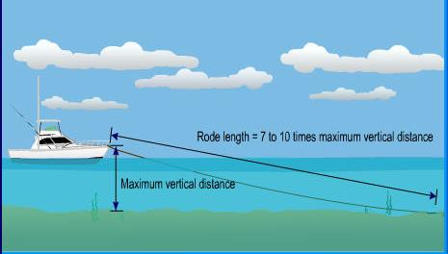
Anchoring Technique
Notes:
Don’t forget to add waterline to bow measurement in calculating rode length.

Slide 27
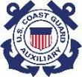
Anchoring Technique
Lower anchor over the bow and let skipper know when it is on the bottom – never anchor from stern
Skipper slowly backs away – motion of boat will set anchor
Check on shore references to be sure anchor is set – check for tight line
Boat may move forward if anchor is set properly
Dragging anchors sometimes self-set with more rode
Notes:
Explain why a horizontal pull is required to set the anchor. Explain why it is a good idea to have a length of chain to help achieve the horizontal pull and to help with reducing abrasion of the rode on the bottom.

Slide 28
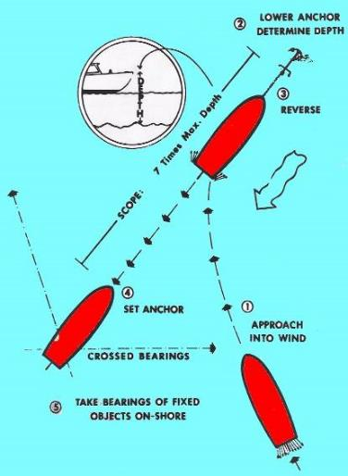
Anchoring Technique
Notes:
Explain that it is necessary to gauge your relative position to objects on shore (crossed bearings) to determine if you are getting closer to the objects on shore or are staying in the same spot. Explain it is normal for the boat to swing in an arc as the wind and current moves it, but you should not be moving closer to shore. If this occurs and you have sufficient room, often letting out more rode to increase scope may reset a dragging anchor. If this fails or you run out of room or depth, it may be necessary to reset the anchor in a new location.

Slide 29
Retrieving the Anchor
Direct skipper which way to move the boat as rode is pulled aboard and you come up directly over the anchor
Pull anchor vertically and if it won’t come up, cleat the line and nudge forward – you will feel anchor pop out
Properly set anchor will likely have mud or weeds on it so wash it off by dunking unless you want mud or weeds in your boat

Slide 30
Useful Knots
Bowline is the king of knots on a boat – makes a loop of any size that can be easily untied
Clove hitch is useful for temporary ties where pressure is maintained on the line
Round turn with two half hitches is a good general purpose knot but can be hard to untie after loading
Knots by Grog https://www.animatedknots.com/ is an excellent animated knot instruction website.
Notes:
Ideally, have a hands-on knot tying session if time permits. If you can show the bowline, clove hitch, round turn with two half hitches, and belaying to a cleat, you will have demonstrated the most used knots helpful to boaters.
This is always a big hit with students but is very time consuming. Perhaps use as additional one on one time or as an extended session as time permits.

Slide 31
More than this taste of what we offer
Education classes from entry level NASBLA certificate courses to Coast Guard Boat Crew qualification and certification training for members
Ability to train and earn qualifications to support Coast Guard missions alongside or in place of active duty as a volunteer
Ability to make a difference serving your communities and the nation in Recreational Boating Safety missions
Notes:
Explain NASBLA Certified courses and state requirements as applies. Explain reciprocity of education for NASBLA certified courses accepted by other states if you boat in their waters.
Explain that our member training is to Coast Guard standards that meet Commandant’s Instruction. No other boater education meets these standards.
This is your chance to “sell” the Auxiliary. Ensure you have recruiting material available for anyone expressing interest and get their contact info to forward to your FSO-HR.

Slide 32
Next Steps
Additional education class opportunities can be found at www.cgaux.org and click on Take A Boating Safety Class or ask your presenter for more information.
To request a FREE Vessel Safety Check, go to www.safetyseal.net or www.cgaux.org and follow the link to the vessel safety check pages or ask your presenter for more information.
Information on membership in the Auxiliary can be found at www.cgaux.org or ask your presenter for more information.
Notes:
Point out the high quality and low cost of an Auxiliary certificate course. Be prepared to sign up prospective students to take a class.
Mention that the VSC is a free voluntary courtesy exam to help educate boaters about required safety gear and other gear a prudent boater should have although not legally required.
Be prepared to have recruiting materials available to give to prospective members. If possible, have your FSO-HR or another person present who can talk membership with the prospect.

Slide 33
Take-Away Messages
Wear a lifejacket while boating
Get a free Vessel Safety Check
Know before you go
Maintain situational awareness at all times
Don’t drink and operate a boat
Sign up for additional education training
Notes:
Quickly sum up the take away message bullet points. Consider adding this to your list of resources handout and use some or all of it in your marketing prior to the event where this presentation is used.

Slide 34
Questions?
We hope you enjoyed this seminar
Thanks for your time
For more information contact:
www.cgaux.org
Notes:
Put in local contact info in your resource handout document. Add local contact info below the www.cgaux.org line.

